Slide 1
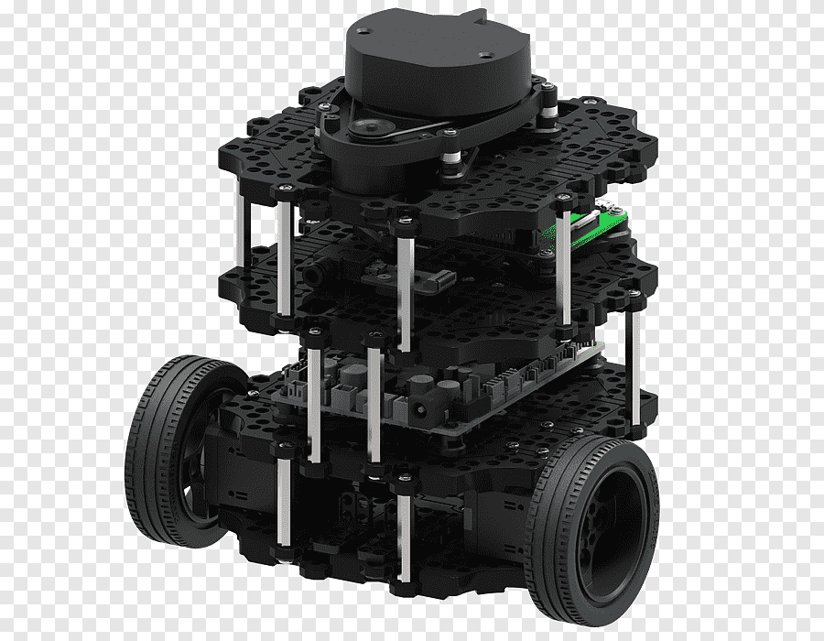
Ros Basics in 5 days (python) Wall following

Slide 2
toPICS
Subscriber: /scan (callback function)
Publisher: /CMD_VEL

Slide 3
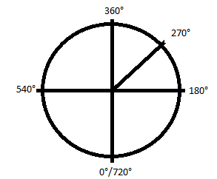
Callback function
Discovering the angles
If (frontal distance <= 0.5 meters): turn left
Elife (Right distance > 0.3 meters): turn right
Elife (Right distance < 0.2 meters): turn left
Else: go ahead

Slide 4
services
Call back function from /scan topic (270 and 360 beam distance).
Call back function from request message to the server service.
identify the beam with the shortest distance (shortest beam).
If shortest beam > 360°: turn left while beam > 360° | ELSE : turn right while beam < 360° .
Move forward until the front ray is smaller than 30 cm.
while shortest beam > 270: turn left.

Slide 5
action
Call back function from /odom (get position, calculate distance ).
Call back function from goal messagem from cliente action (feedback Every 1s, result if distance > 6m)

